Slide 1
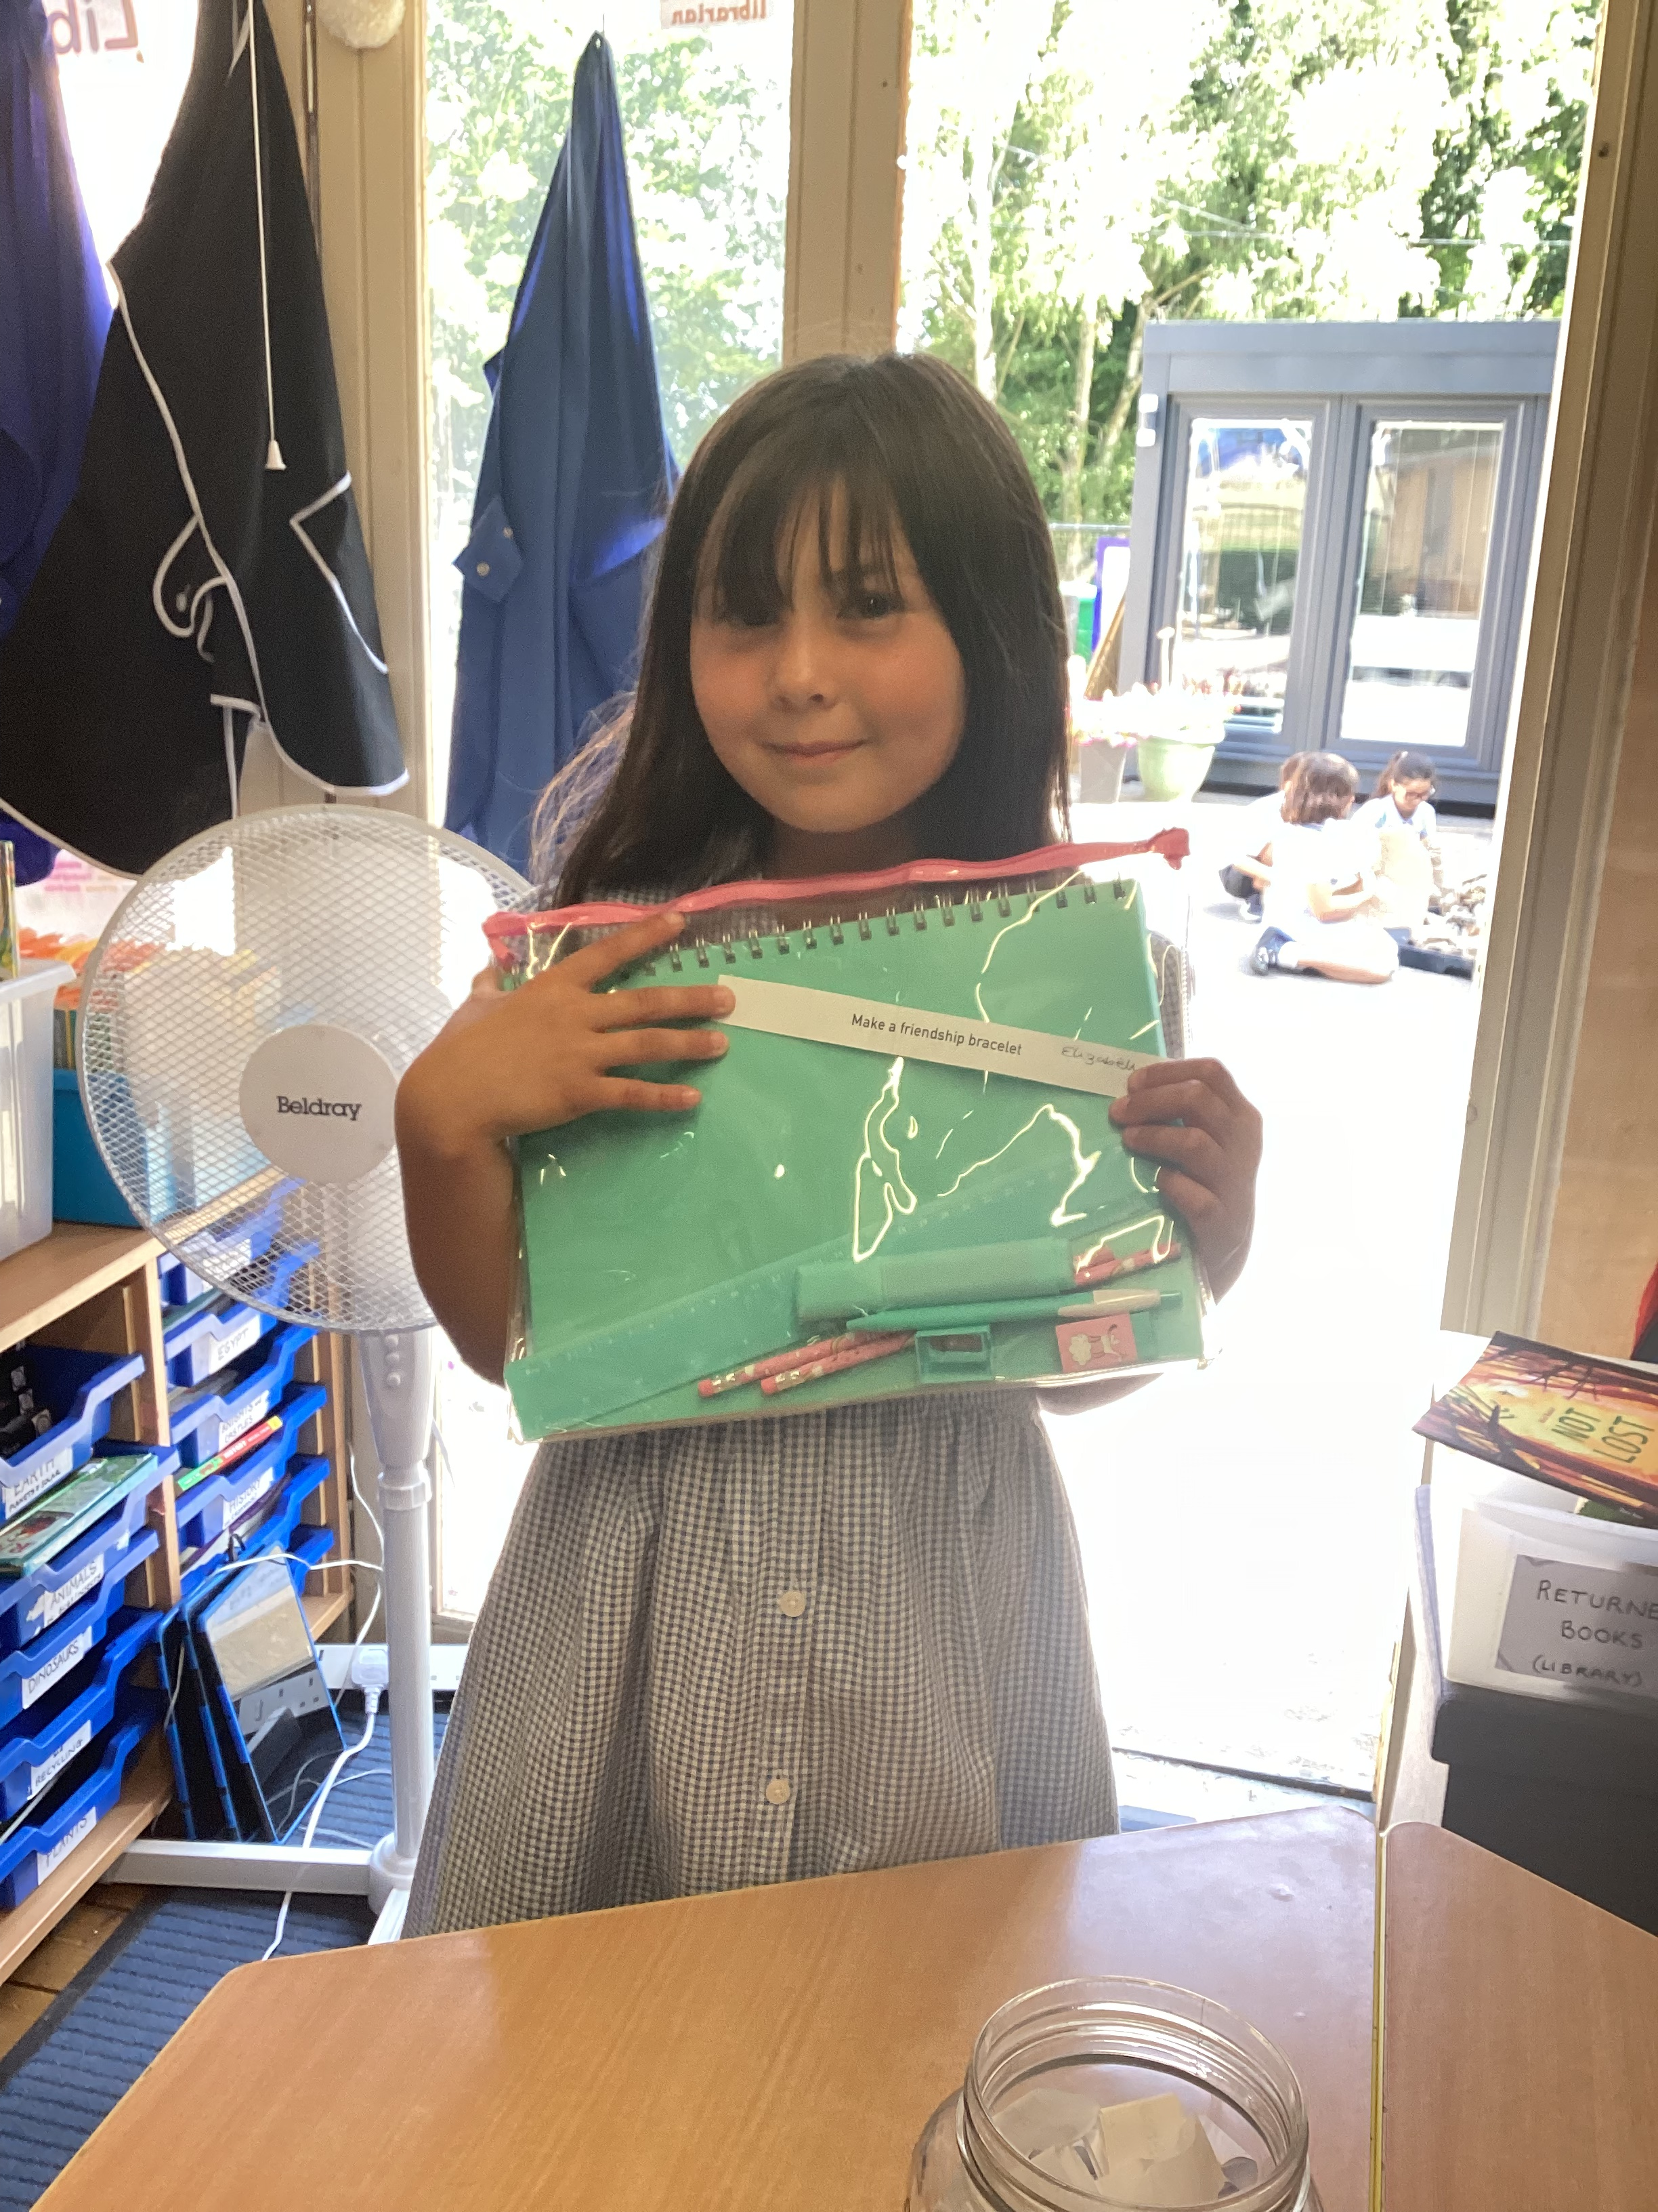
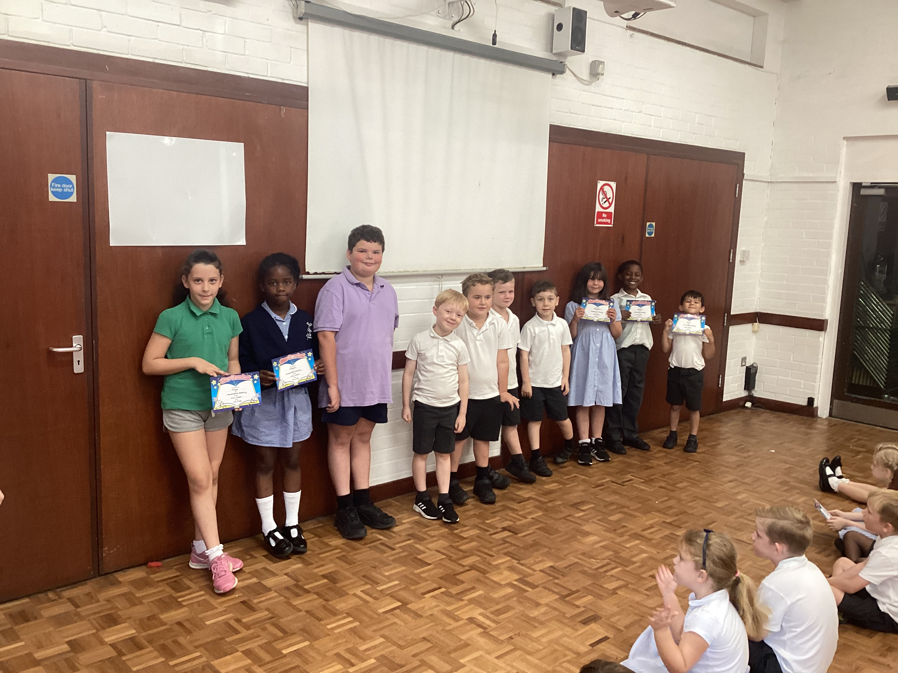
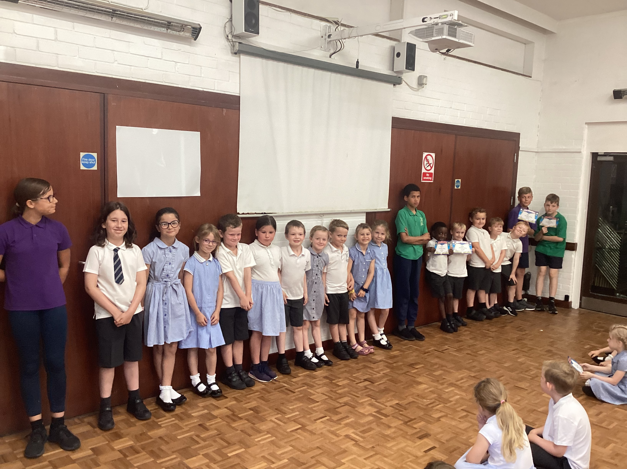
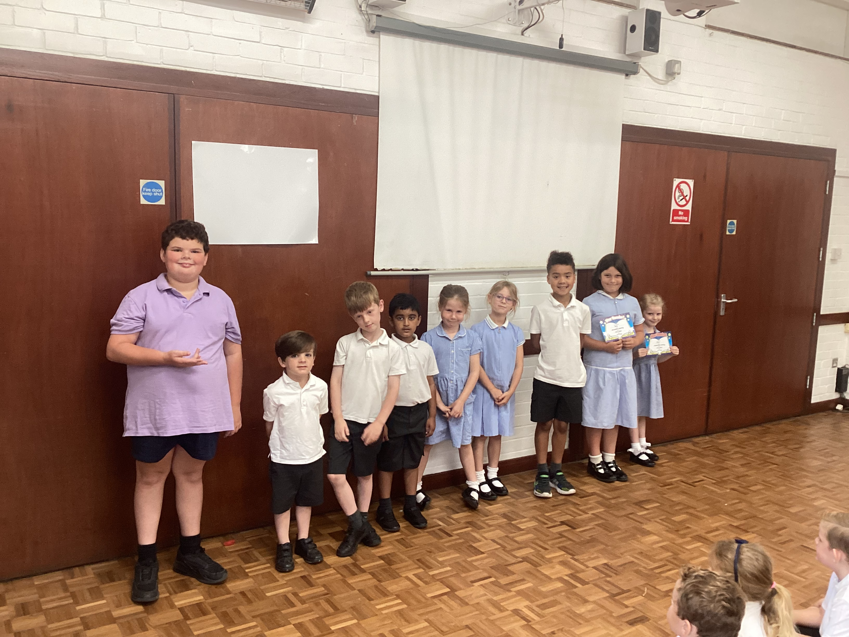
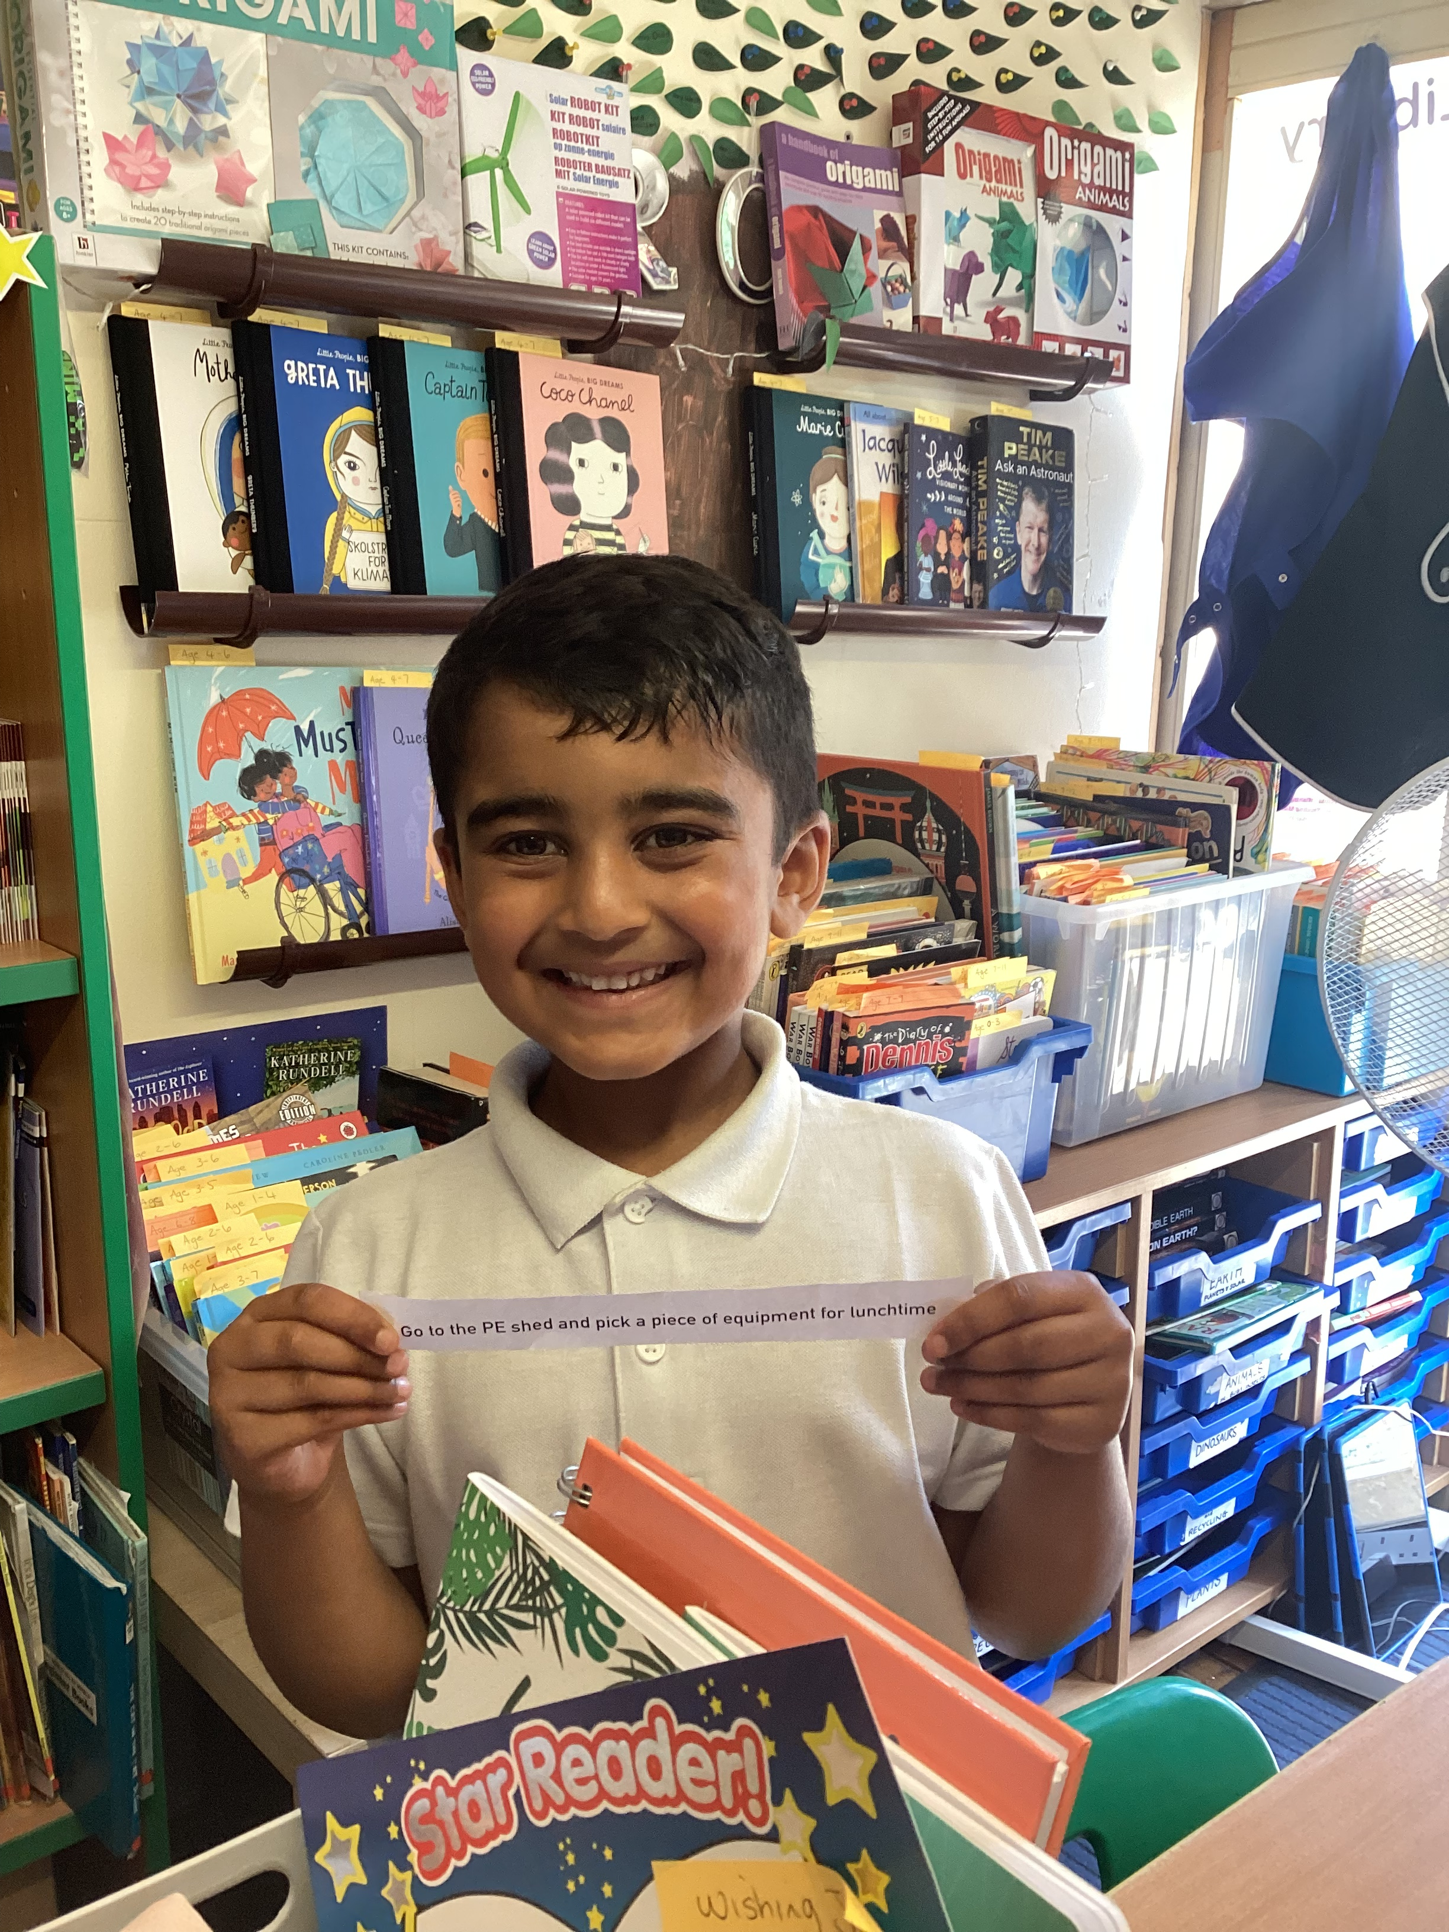
This is the 6th and last edition this academic term of the Reading Newsletter. We have made huge progress using the Accelerated Reading Program and the Points Scheme. The children have thrived in their reading ability and it shows by all the fantastic winners that have come through the library. We are super impressed with how far they have all come and it’s lovely to see that not only do they love to read more frequently but most of all enjoy the books that they are reading. With the library coming to a close for this 2021/2022 year, we would like to thank all those that have donated books to the library. We love getting new or used books especially if they can be used as part of the Accelerated Scheme, as the children will get so much use out of them and they can gain more points: points mean prizes!! So that being said if there any books that you will be disposing of this summer, please please pass these forward to us in the new term, any book, regardless of what it is will be hugely appreciated. Thank you and have a fantastic summer holiday. See you next term!
Rodmersham School
Reading Newsletter
July 2022
SCHOOL’S OUT!!
Farewell Year 6
We would like to say a fond farewell to the Year 6’s. Being part of the school for 8 years, I have watched these children blossom into wonderful mini adults, with some having a huge point tally at the end. Having this system in place for the last 2 years despite having to deal with Covid, the system has proven very effective for all children and their reading abilities. Eva Jury, Lucas Phillips and Evandale Ngondo - Bittner having the highest of their year. Congratulations on their fabulous achievement and we wish all the Year 6’s a wonderful transition into secondary school in September.
Book Corner
Congratulations to our July winners that have been awarded Wishing Jar, Vending Machine and STAR prizes. Our last one proved very popular. We had 38 winners!
Every month we award the STAR prize winners with Ice-cream factory. They love this award, it is a real treat. Well done to you all, you are amazing readers!
Fun Facts
Did you know that the overall winner of the reading point scheme this year was ………
Matilda Flatt!!
Fun Facts
Did you know since the reading scheme has been in place, there have been 262 winners. 116 for the Wishing Jar and 87 for the Vending Machine. 59 of them have been STAR prize winners. Well done everyone!! ☺

