Slide 1
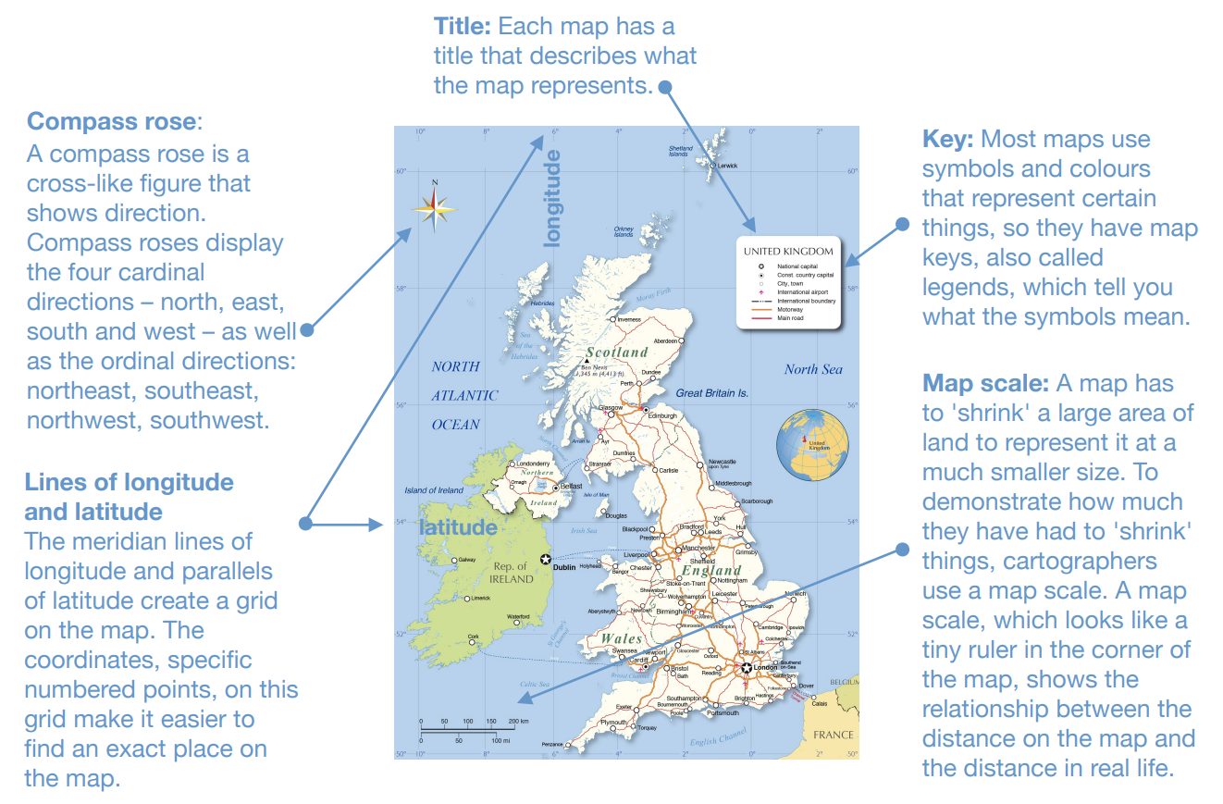
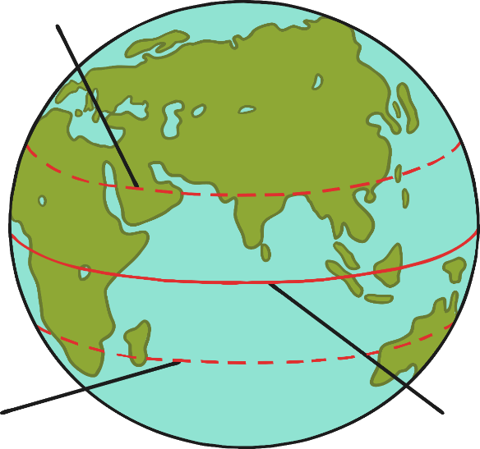
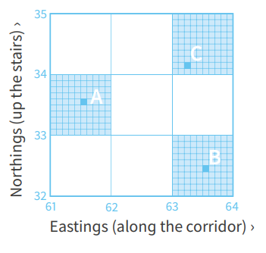
MAPS
When?
When?
Where?
Who?
What?
So what? (impact)
How do we know?
What’s the same/what’s different?
Settle-ments
Maps
Biomes
South America
North America
Where?
0
2,000AD
Who?
When?
What?
Germany
Adolf Hitler
Luftwaffe
Axis
Nazi Party
Herman
Goering
Italy, France, USSR, Japan, USA
What?
BC – Lines of Longitude and Latitude
1939 – Grid references
2013 – What-3-words
So what?
⚡
Where?
📖
How do we know?
🧩
Tropic of Cancer
🔒
🔓
What’s the same/different?
the
tropics
Tropic of
Capricorn
Equator
So what?
⚡
Navigation
Emergency Services

