Slide 1
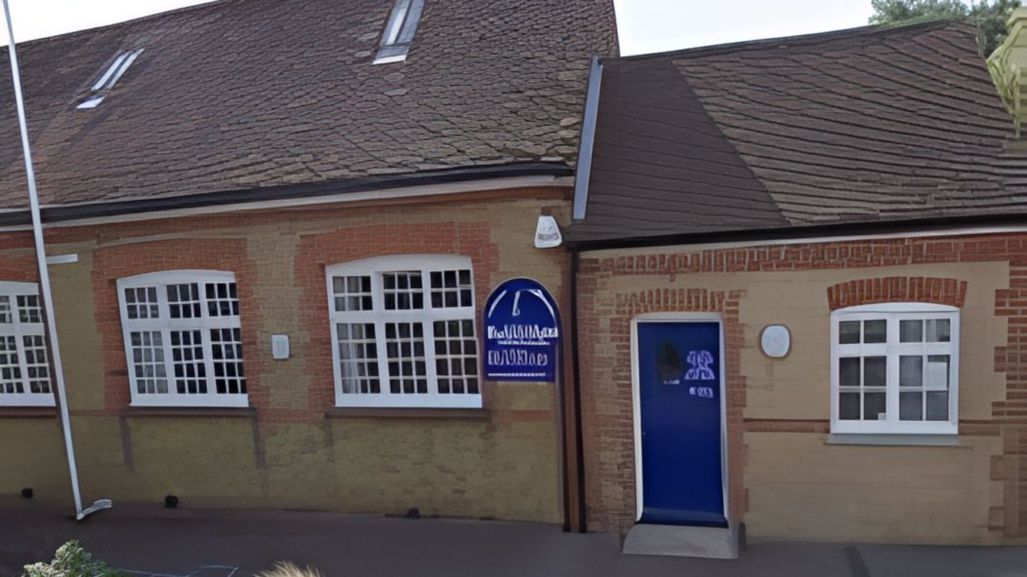

PROSPECTUS 2025-2026
Rodmersham School
Head Teacher: Mrs McMullon

Slide 2

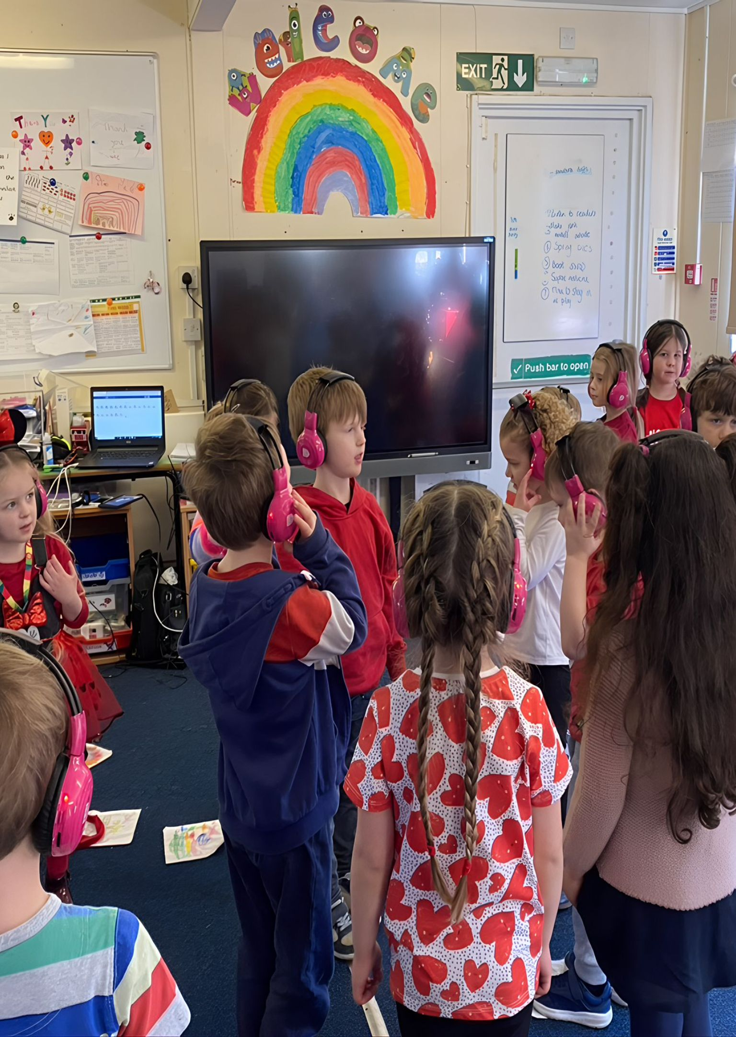
WELCOME
Welcome to Rodmersham School
I am proud to lead our small village school. What we lack in space, we make up for in enthusiasm.
We want everyone to be happy, be themselves and sparkle. Children’s and staff wellbeing comes first: feeling valued and belonging help us function.
Education is a joint venture between children, parents, staff, Governors and our community. Our door is always open.
Nicky McMullon, Head Teacher
headteacher@rodmersham.kent.sch.uk

Slide 3
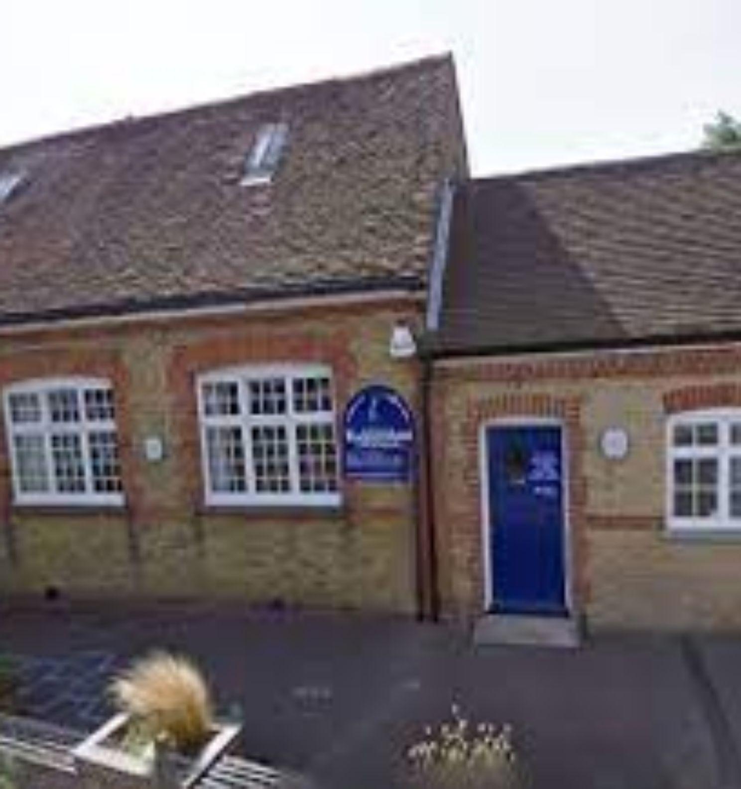
Our school
Small by design: seven classes, one year group each
7
Small, single-year classes give secure foundations from day one.
10
Published admissions number per year.
Our talented, hard-working teaching and non-teaching team makes joining smooth and meets everyone’s needs.
Rodmersham School

Slide 4
Joining us
Admissions
Kent County Council allocates places. Our Admissions Policy is on the school website.
As a maintained school, we apply these criteria in order:
Reception team
Reception has one teacher and one full-time teaching assistant, with extra adults when children’s needs call for them.
Looked After Children
Sibling
Medical
Distance

Slide 5
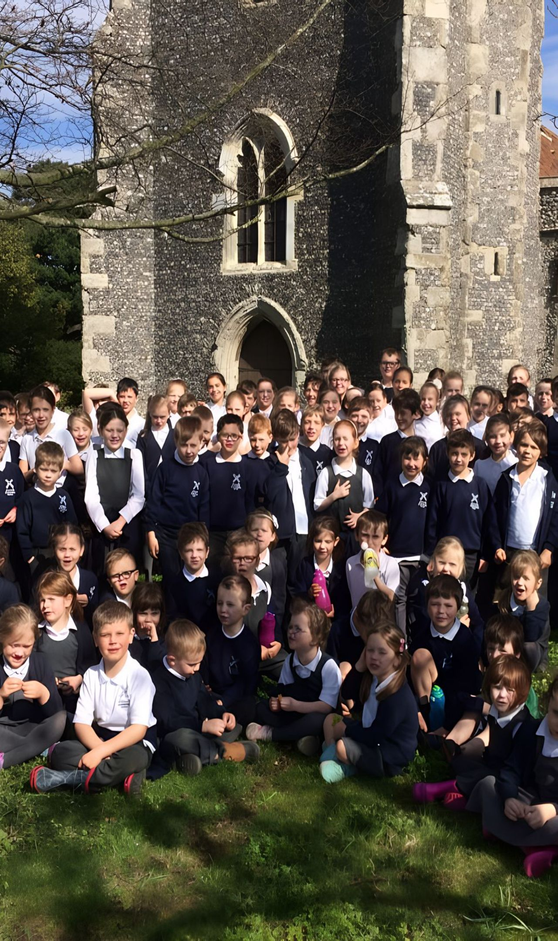
OUR PEOPLE
Meet our class teams
Class | Teacher | Assistant educator
1 | Miss Davenport | Mrs Dodd, Ms Rains
2 | Miss Williams | Miss Stephani
3 | Mrs Henderson | Mrs Williams
4 | Mrs Cooper | Mrs West
5 | Mrs Beaney | Mrs Stanley
6 | Mrs Foord | Mrs Cornish
7 | Mrs Phillips | Miss Bing

Slide 6

Our people
The people who keep us running
Family Liaison Officer (FLO)
Dinner staff
Mrs Potter
Mrs West, Ms Bayley, Mrs Dodd, Mr Cox
Cleaner in charge
Office manager
Sports lead
Mrs Harrison
Mrs Flatt
Mr Cox
Breakfast club
After school club
Mrs Croucher
Mr Cox

Slide 7
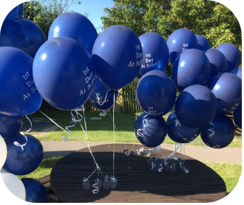
Joining Reception, step by step
01
02
03
Summer meeting
Two visits
Teddy Bear Picnic
One September intake. Meet the Head Teacher and Class Teacher in the summer term.
Afternoon visits introduce the teacher, teaching assistant, classroom and resources.
On the third afternoon, children picnic while Mrs McMullon meets parents over tea and cake.
04
05
06
Pre-school links
Transition box
A gentle start
In Term 6, the Class Teacher and Teaching Assistant visit every setting and meet key workers.
Photos of staff and school go home in a box to fill with summer adventures.
Term 1 starts with half days in week one, full days from week two. Parents drop off and collect in the classroom.

Slide 8

A typical day in Reception
Time | Activity
8:40-8:55am | Children arrive
9:00am | Child-initiated and early morning activities
10:00-10:15am | Snack
10:15-10:30am | Break
10:30am | Teacher-led activity
10:50am-12:00pm | Child-initiated
12:00-1:00pm | Lunch
1:00-1:30pm | Phonics
1:30-2:30pm | Child-initiated
2:30-3:00pm | Daily walk through the orchards and fields
3:00pm | Story time
Reception children have a free school dinner or bring a packed lunch. Everyone eats and plays together.

Slide 9
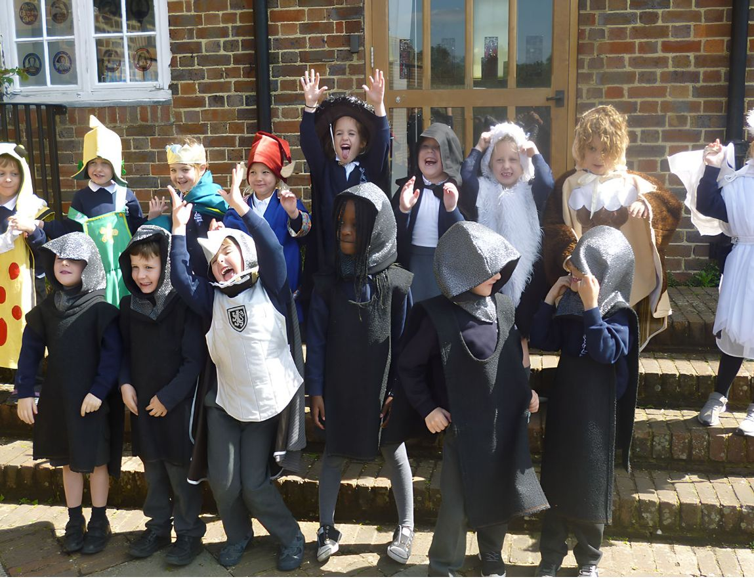
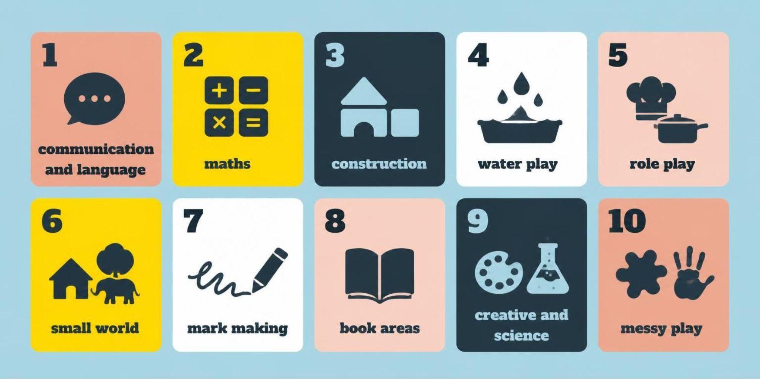
Inside the Reception classroom
A large learning space with its own toilets and a well-resourced outside area supports the seven areas of learning.
Careful assessment and observation, including information from parents and other settings, shape the balance. If progress in a prime area raises concern, staff talk with parents and may involve the SENCo to access Additional Needs support.

Slide 10
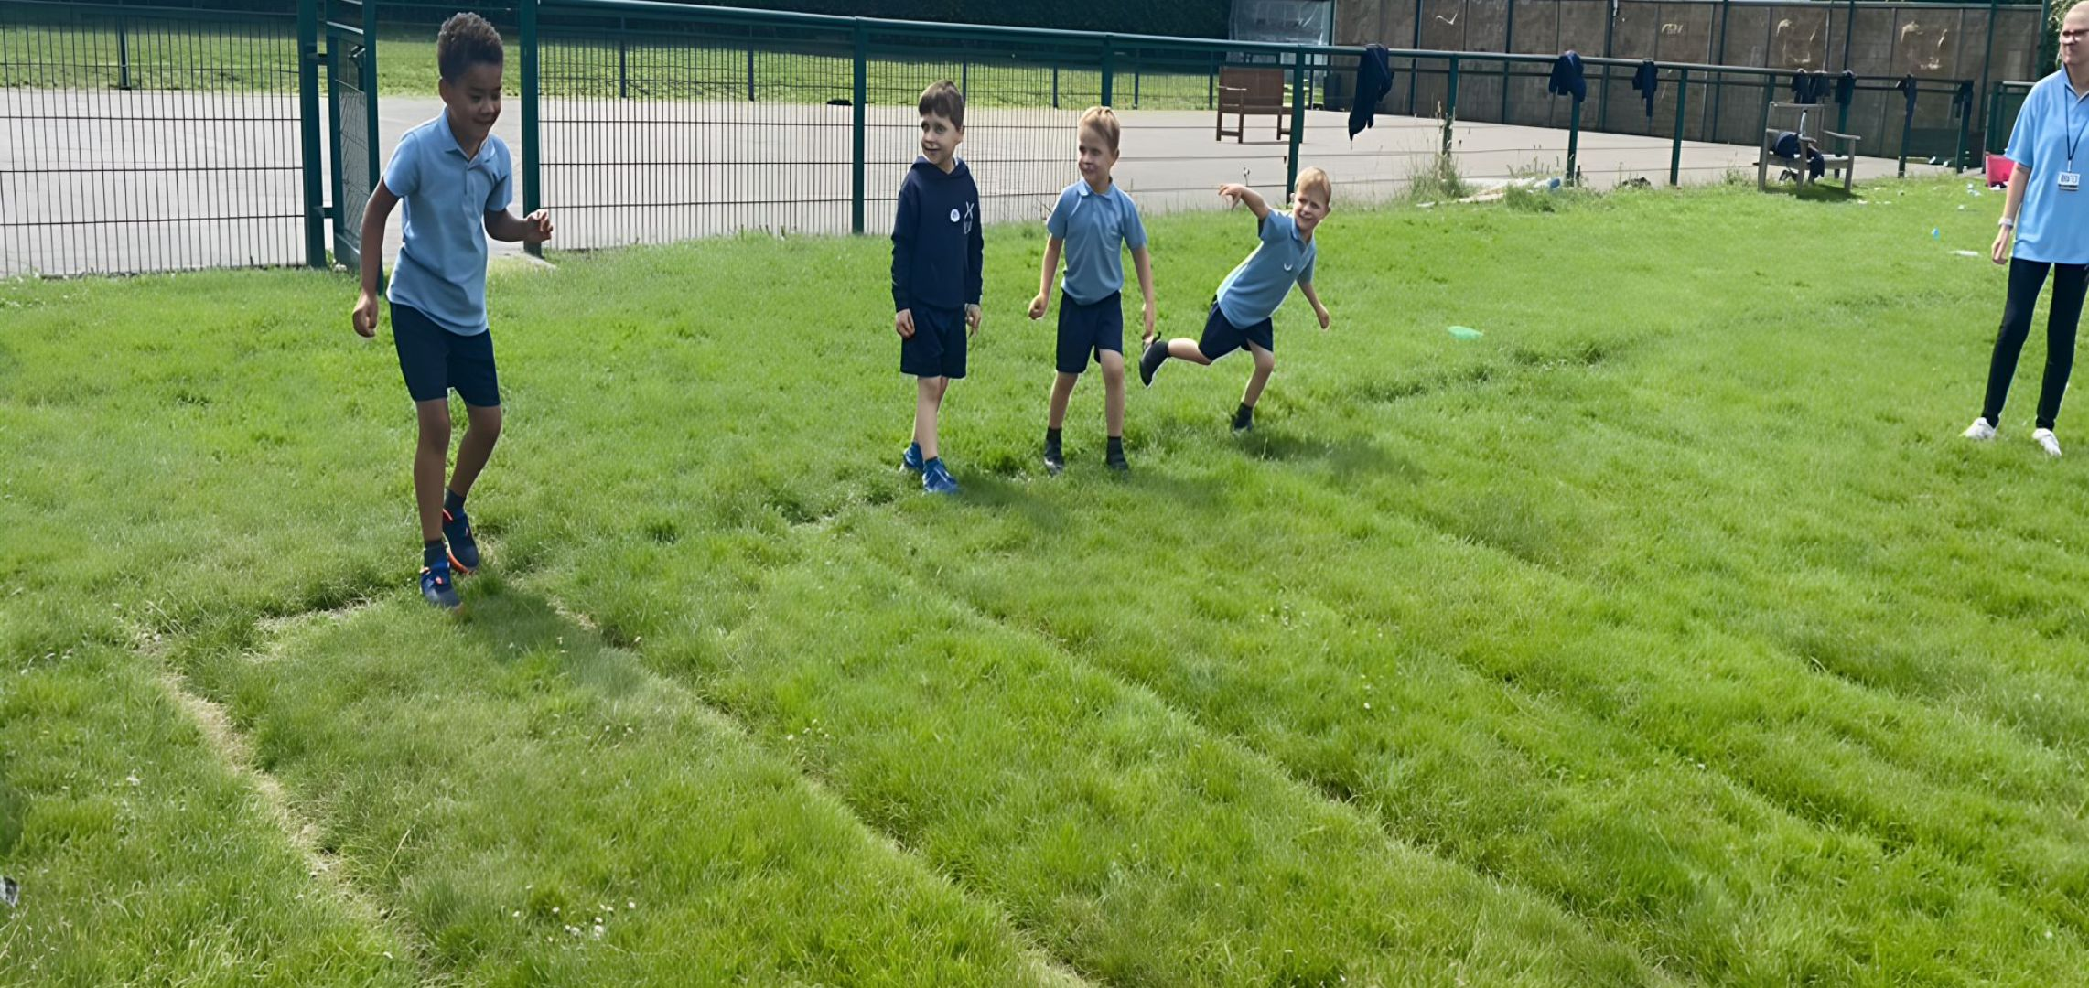
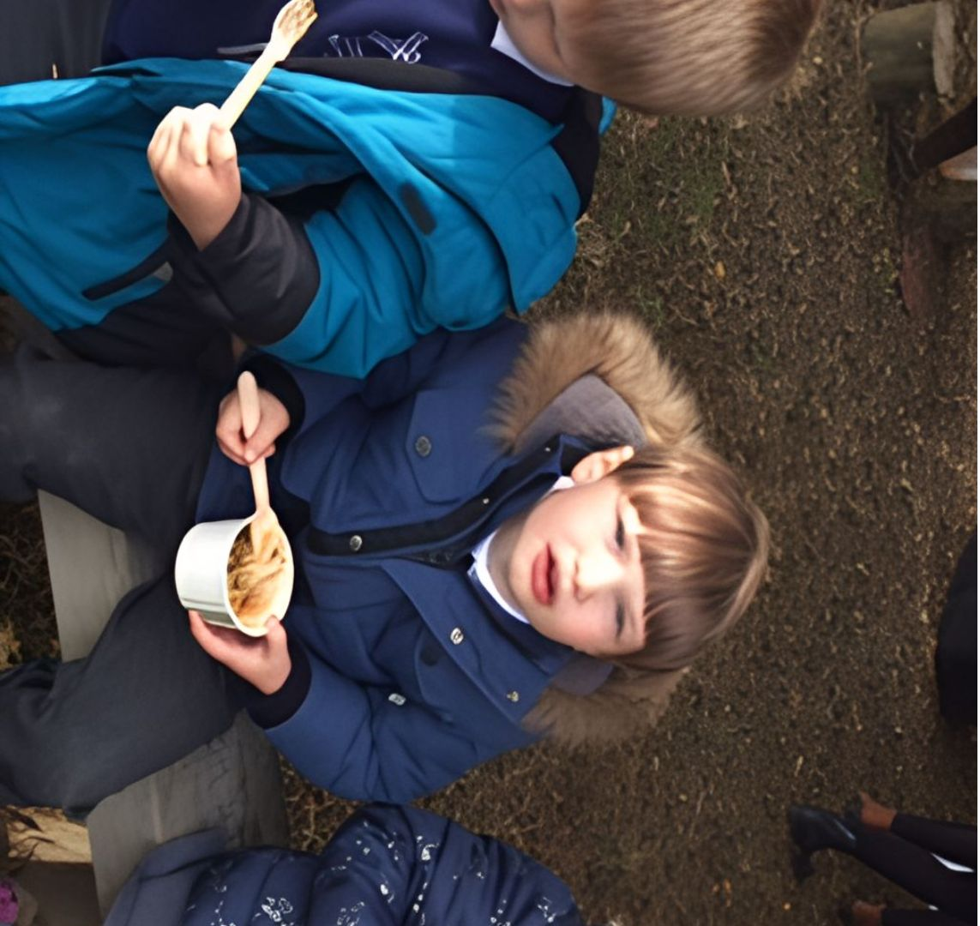
Learning that spills outdoors
Our large outside space inspires curiosity, physical challenge, exploration and imagination. Reception children free-flow outside throughout the day; staff help everyone try the full range.
A large canopy shelters smaller-scale activities. Forest School adventures range from den building to cooking on the fire pit.

Slide 11
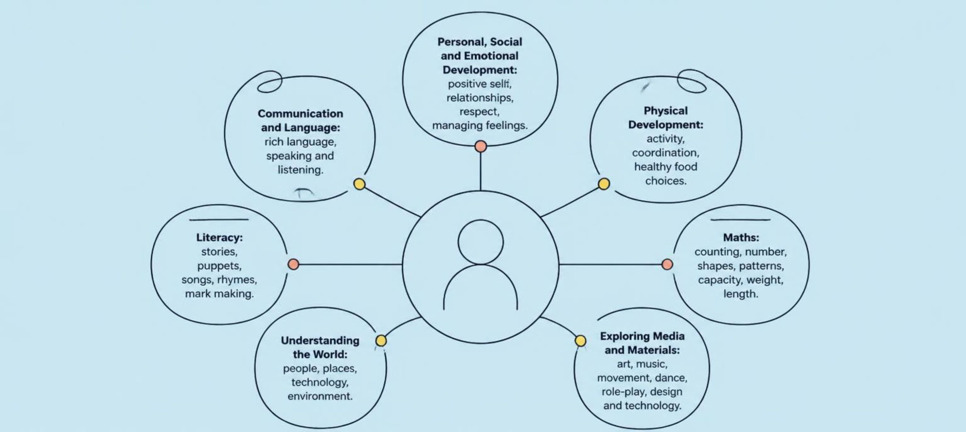
Seven areas of learning
We follow the Early Years Foundation Stage through planned, purposeful play.

Slide 12
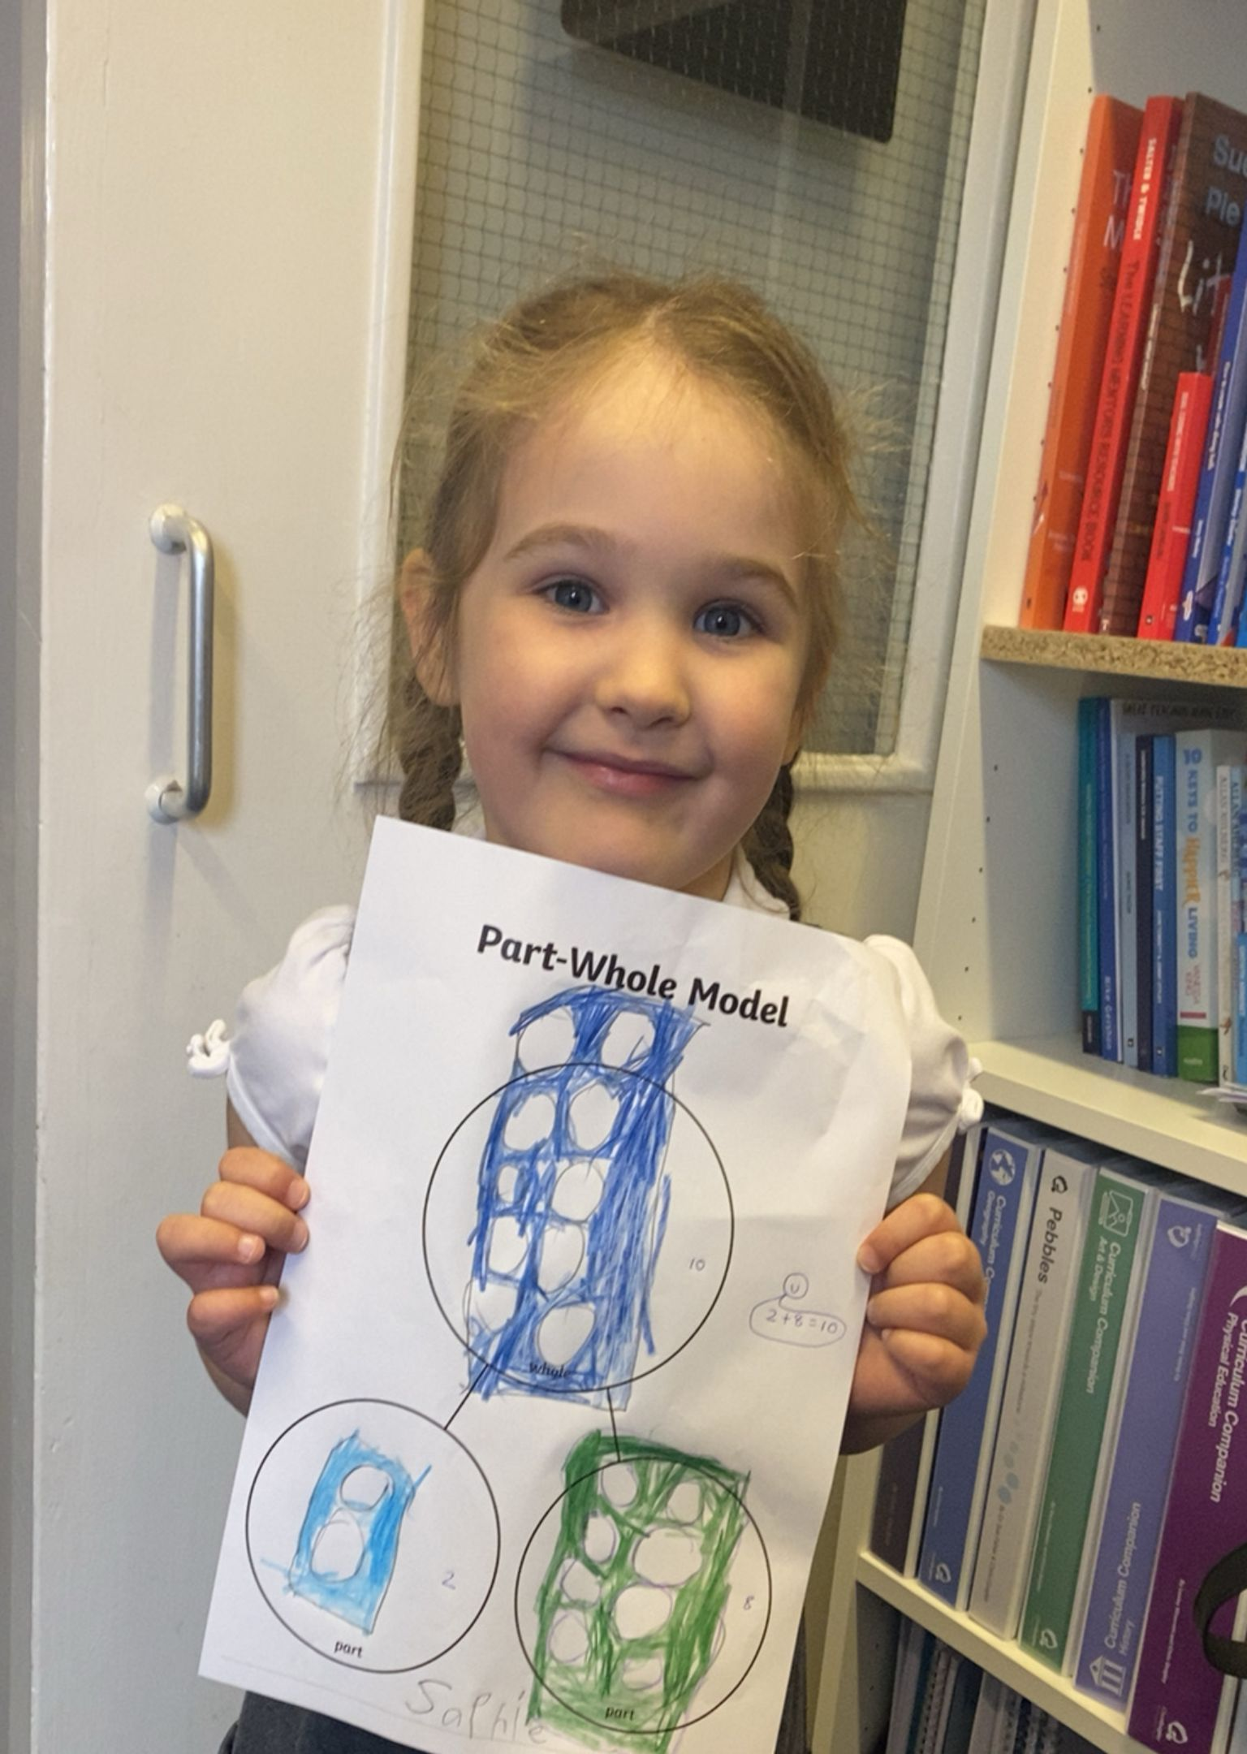
How we know your child
1
Notice each day. All adults observe children daily to support assessment.
2
Share on Tapestry. Parents can view observations on our online learning journey from home and add their own.
3
Agree next steps. Each term, meet your child’s key person, look through their records and agree next steps together.

Slide 13
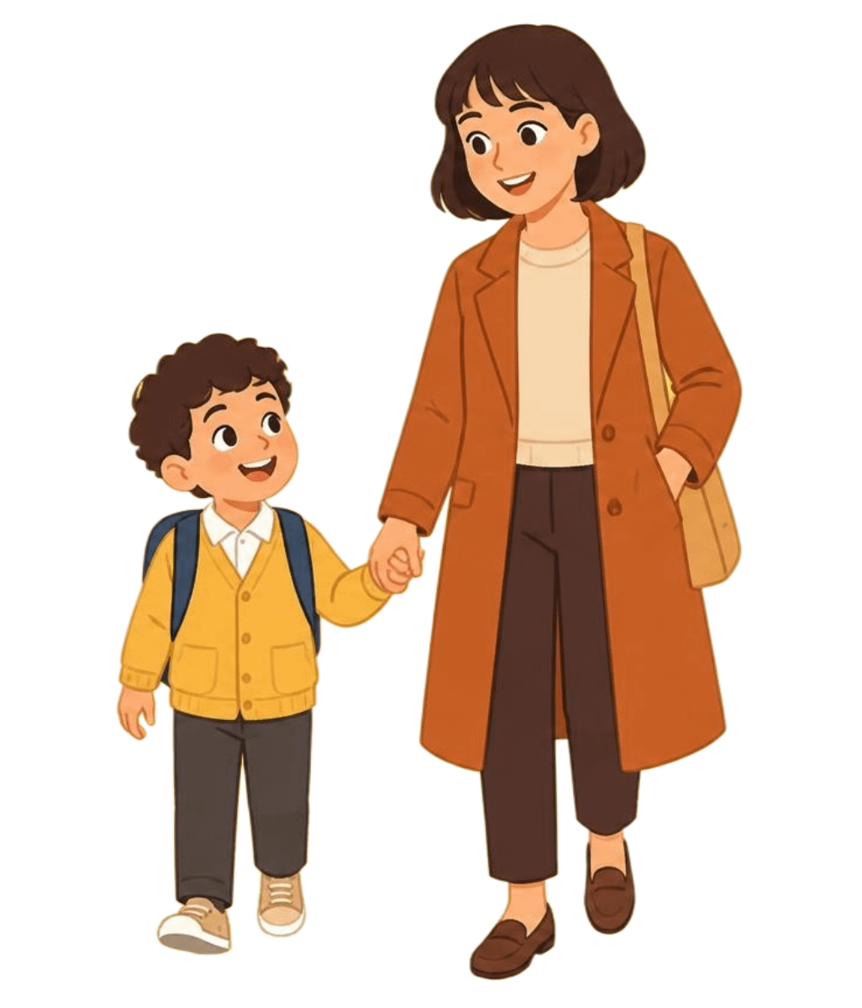
Safe, secure and well looked after
Safe collection
Tell the office or class teacher through Class Dojo who is collecting your child. Introduce new collectors: we never release a child to an unknown person. A responsible adult must bring and collect Reception children.
People you can talk to
Children learn best when healthy, safe and secure. Our open-door policy helps parents and staff share each child’s needs.
Three staff form our designated safeguarding team. All staff have regular training; our safeguarding policy is on the website.

Slide 14
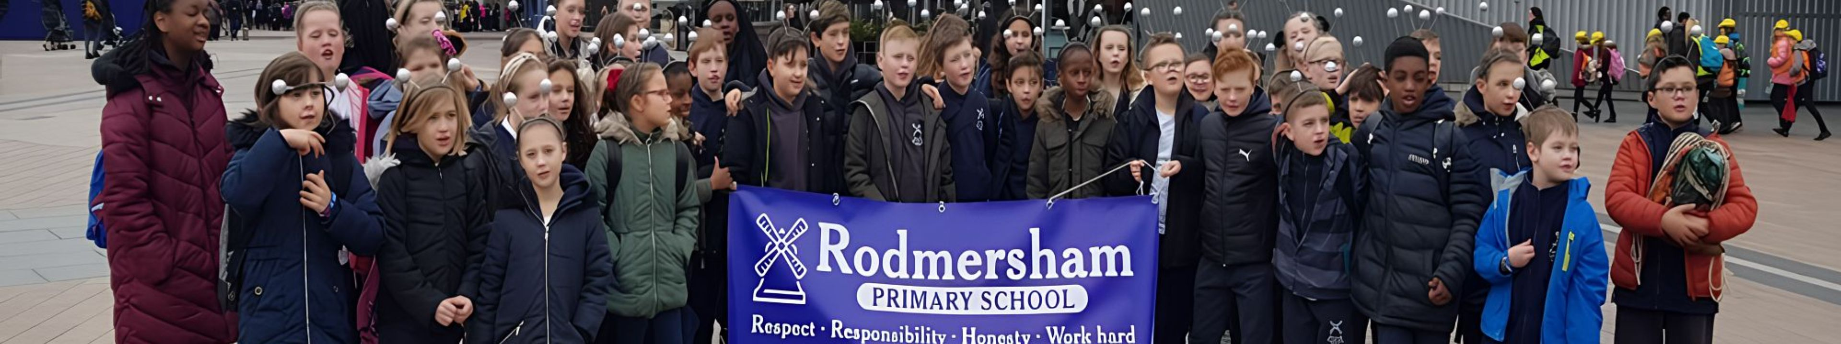
Growing independence
Children develop at different rates, and adults always help. At home, encourage your child to:
Put on their coat and fasten shoes. Slip-ons or Velcro help.
Use and flush the toilet; wash and dry hands.
Use a tissue and cover coughs and sneezes.
Ask politely for help and open their lunch box.
Children ideally should be out of nappies, including pull-ups, unless there is an additional or medical need. Staff are happy to offer strategies and advice.

Slide 15

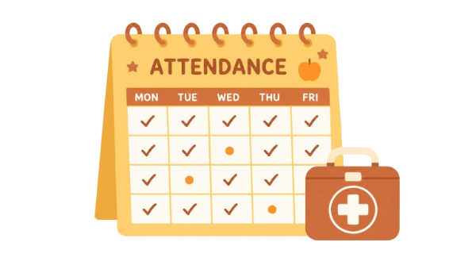

Inclusion, attendance and snacks
Inclusion
Attendance
Snacks
We are very inclusive, work closely with outside agencies and have a full-time SENCo. Our FLO, Mrs Potter, supports families, including with financial support or counselling.
Attend five days a week for the full curriculum. Contact the office if your child is unwell.
Minor accidents receive an end-of-session form. A bumped head means a phone call and letter. A first aider cares for illness or serious injury, and parents are contacted.
Every session includes a free healthy snack: milk or water with fruit or vegetables.

Slide 16

Behaviour: kindness and respect
Personal safety, wellbeing, kindness and respect for all underpin our standards.
Clear expectations
Positive relationships
In the first weeks, we discuss rules and expectations with children. A consistent approach gives clear boundaries and a secure environment.
We praise good behaviour and give gentle reminders. Staff share concerns and exceptional behaviour with parents, building positive relationships through close, continued liaison.
See our behaviour policy for details.

Slide 17
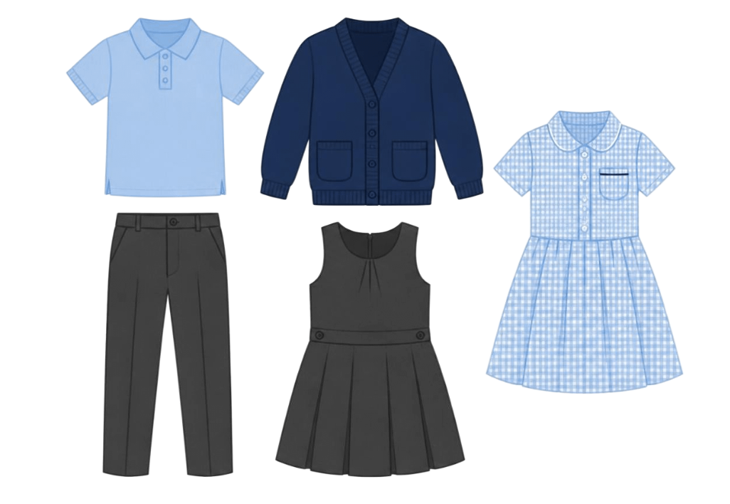
School uniform
We expect all children in uniform, proud to belong to Rodmersham School. Logo items are sold by Forster’s in Sittingbourne. High-street items are fine; Forster’s sells iron-on badges at a small cost.
Grey trousers, skirt or pinafore
White polo shirt or blouse
Navy sweatshirt or cardigan
Navy zipped fleece with logo; navy waterproof zipped fleece with logo
Grey or white ankle socks in summer; grey or black tights in winter
Blue and white striped or checked summer dress

Slide 18
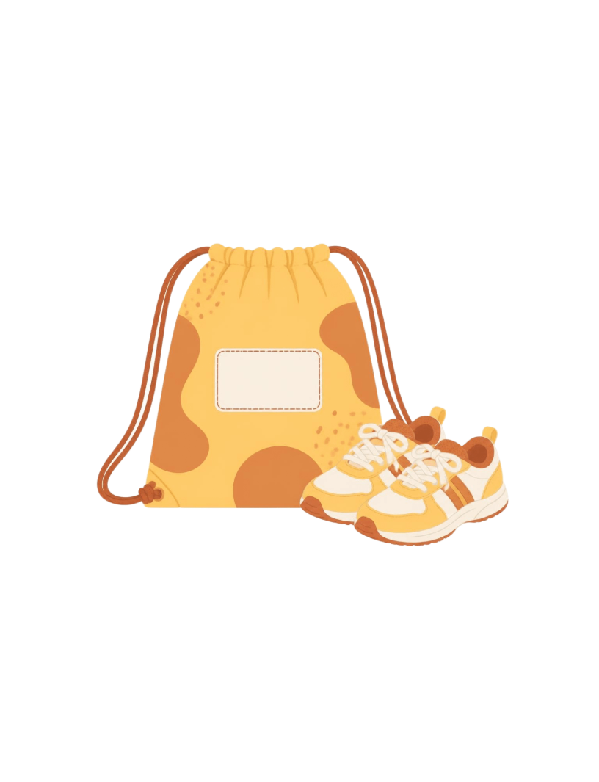
PE kit and personal belongings
Pack and name
Named PE bag: white round-necked T-shirt, blue or black shorts and trainers. In winter, add dark blue or black tracksuit or jogging bottoms and sweatshirt. A book bag, summer hat and sun cream are useful. Name all clothing and equipment; check names stay visible.
Hair and jewellery
No make-up or coloured hair; tie long hair back. No jewellery except KS2 watches and small pierced-ear studs. Children must remove studs themselves for PE; no child wearing earrings can take part. Pierce ears at the start of the summer holidays.
KCC and Rodmersham School accept no responsibility for personal effects.

Slide 19
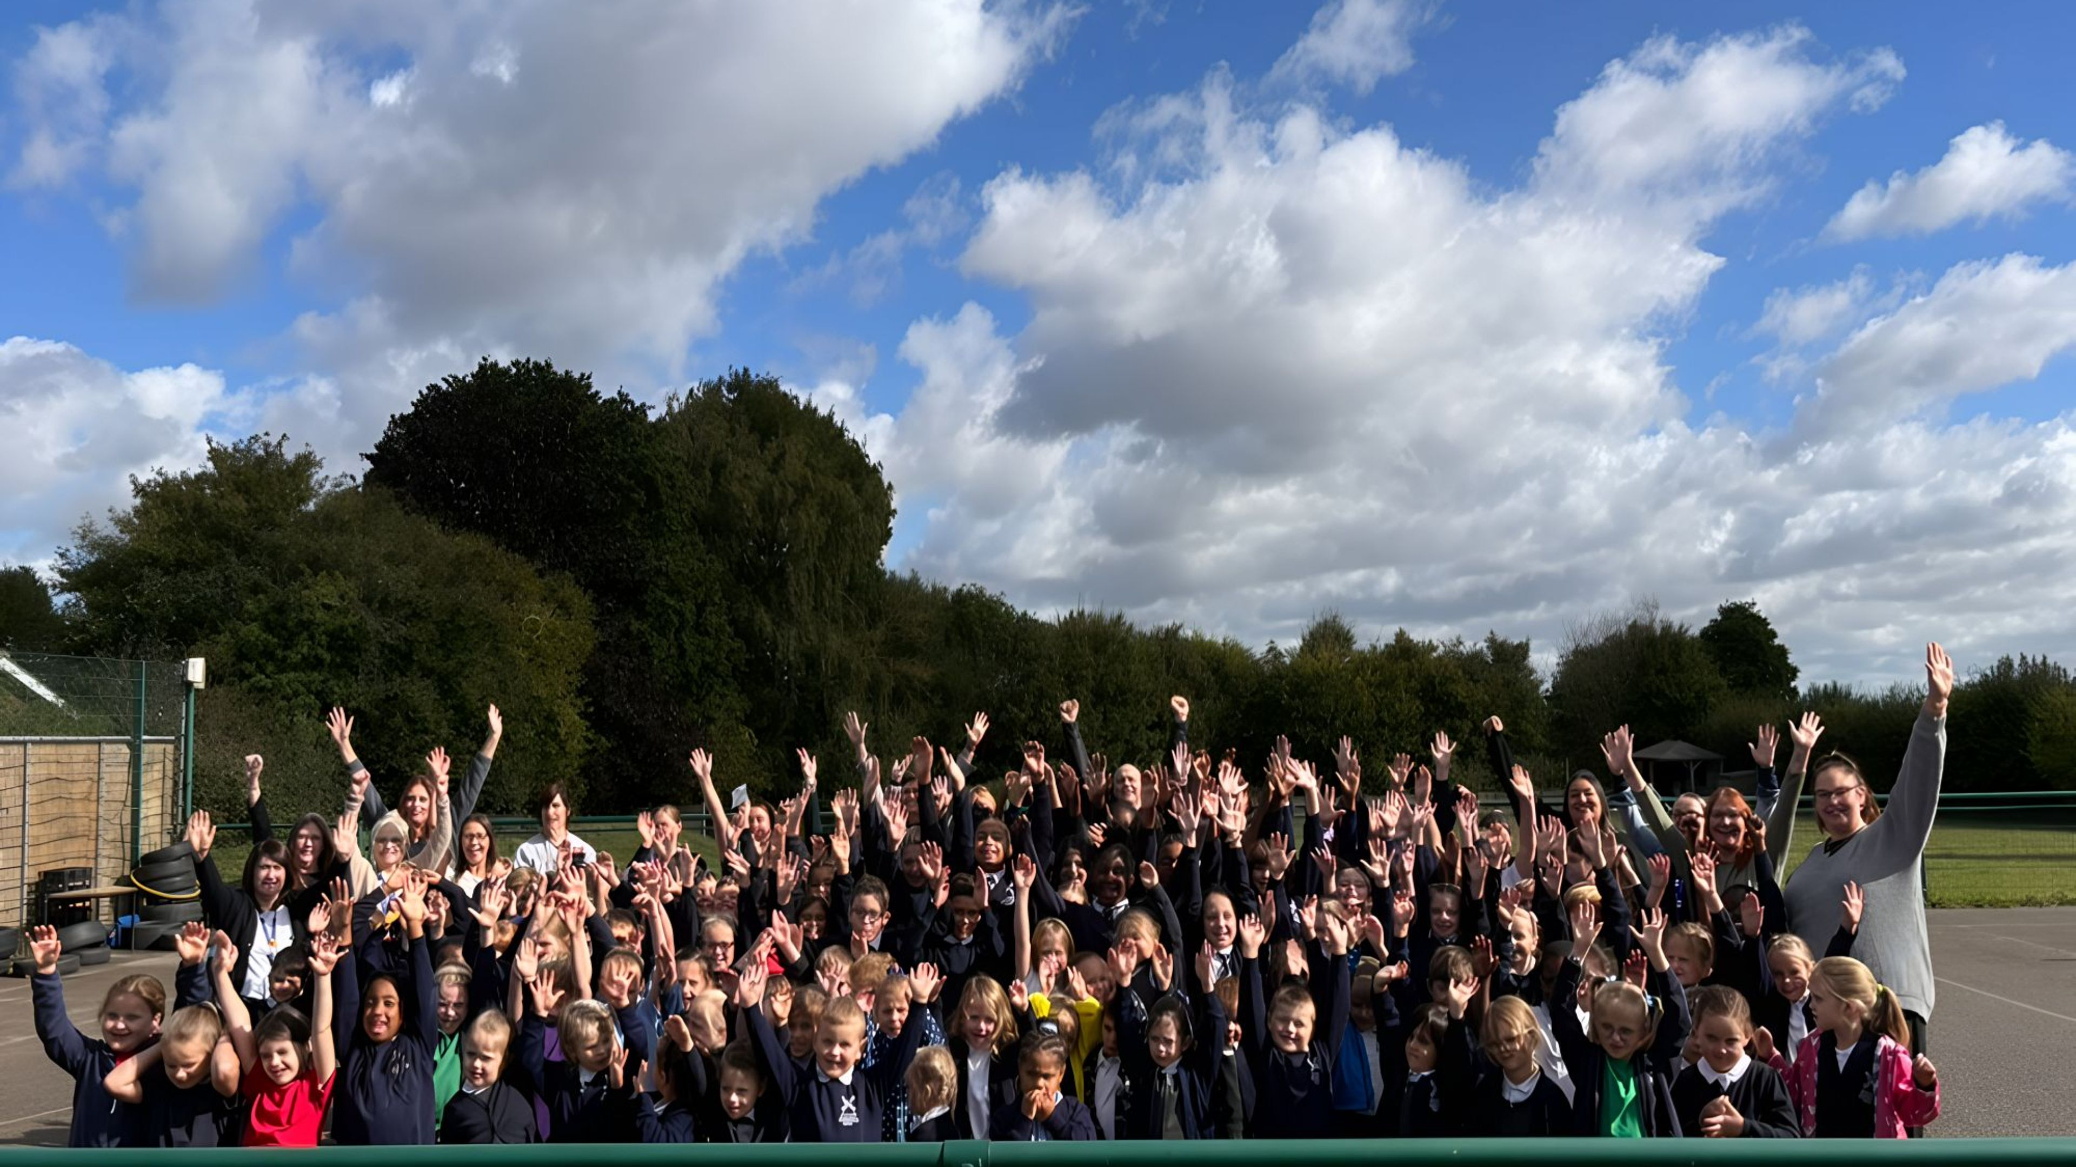
We’d love to meet you
Come and get to know Rodmersham School.
www.Rodmersham.kent.sch.uk
headteacher@rodmersham.kent.sch.uk

